Slide 1
The Sensemaking Process and Leverage Points for Analyst Technology as Identified Through Cognitive Task Analysis
Peter Pirolli and Stuart Card
Abhinab Acharya, Spandan Pyakurel

Slide 2
Few Definitions
SenseMaking Process Process of making sense out of all the information available.

Slide 3
Few Definitions
SenseMaking Process
Cognitive Task Analysis Method used to understand the processes involved(mentally) while doing any task

Slide 4
Few Definitions
SenseMaking Process
Cognitive Task Analysis
Leverage Points Those points if improved upon can create an overall huge impact in the system

Slide 5
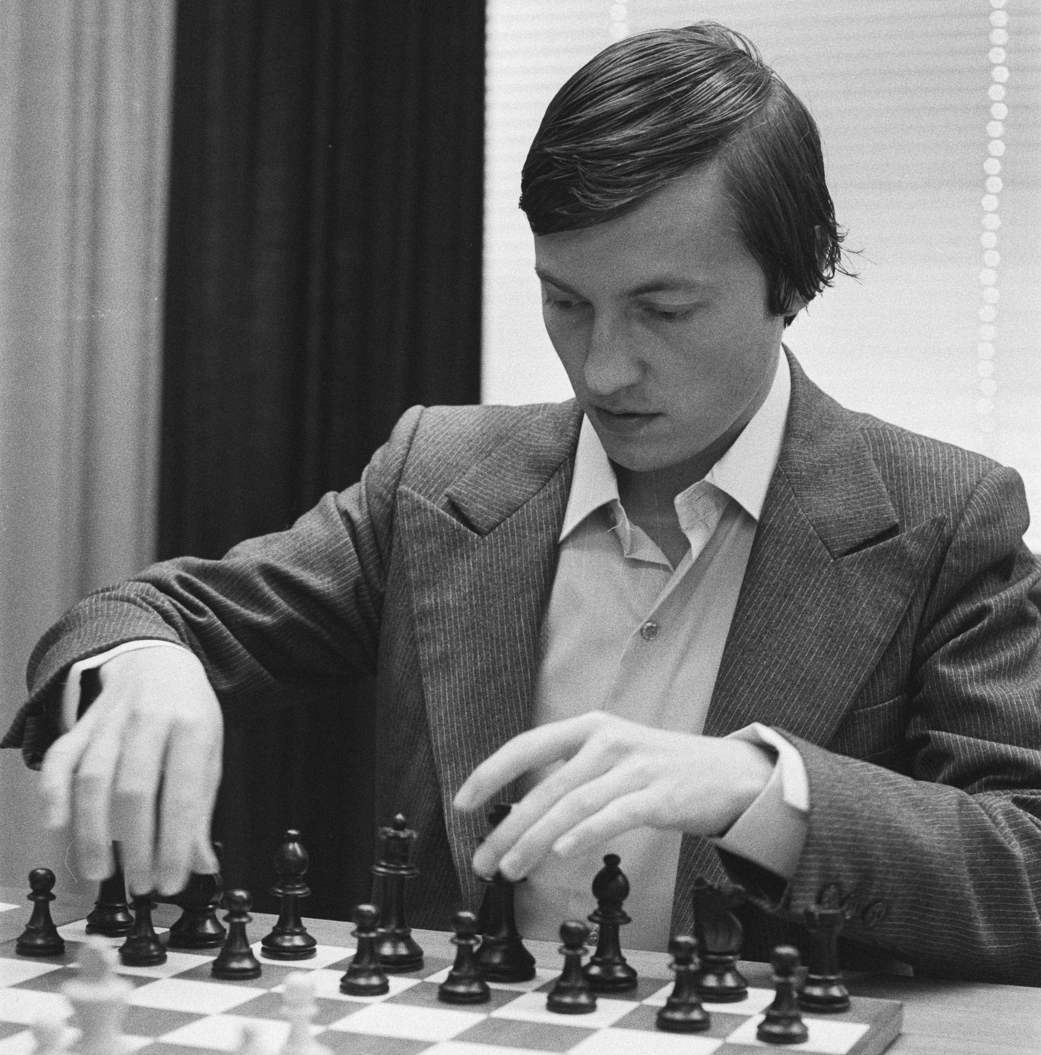
Expertise Schemas
Expectation from experts:
Built up from extensive experience a set of patterns around the important elements of their tasks, called Schemas
Example
Experienced Chess player

Slide 6
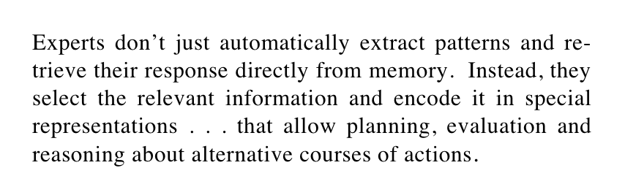
Expertise Schemas
Ericsson & Lehmann (1966) :

Slide 7
Evidence of schemas
Collection of descriptions of people and organizations to predict whether a coup would occur.
map of people, institutions, projects, and biological mechanisms to understand future bio-warfare threats.

Slide 8

Sensemaking Process

Slide 9
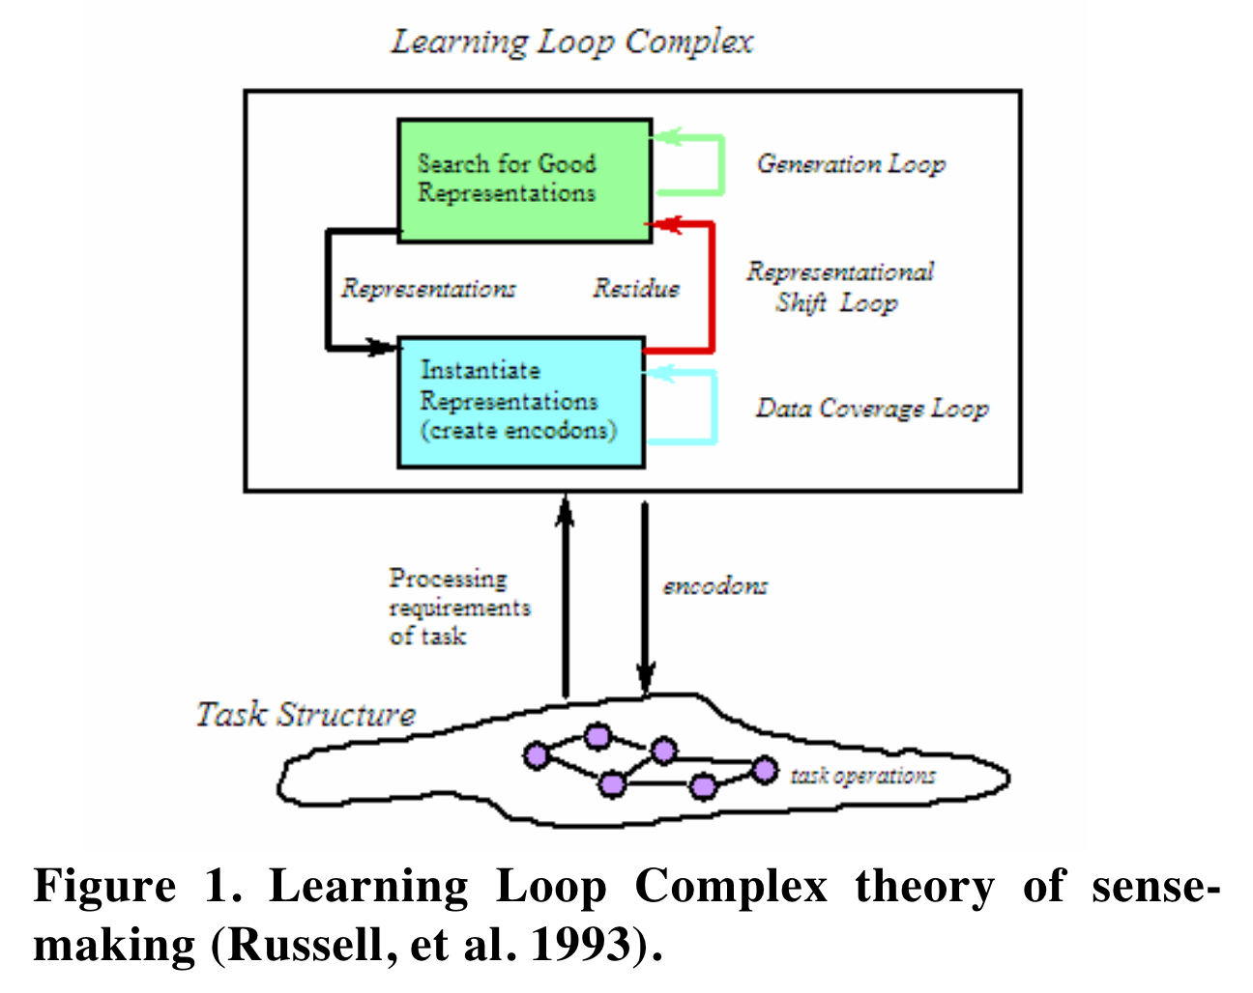
Learning Loop Complex
Generation Loop
Data Coverage Loop
Encode information in representation
Representational Shift Loop
Items that don’t fit -> residue

Slide 10
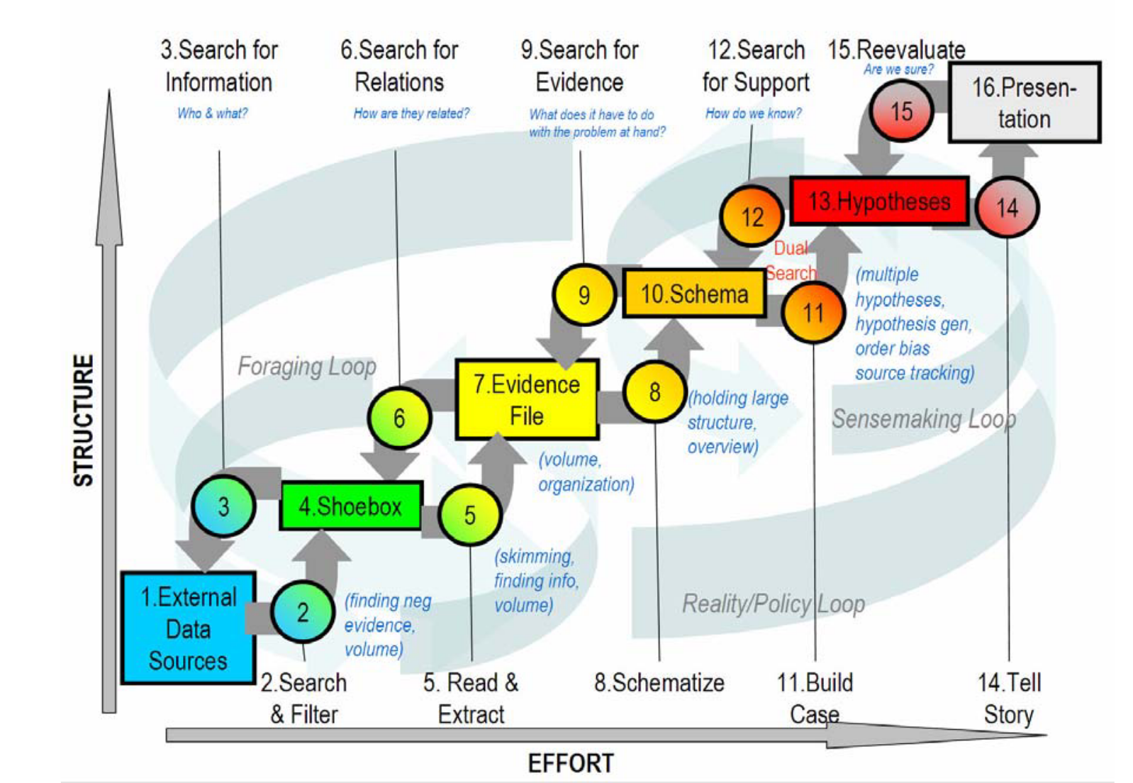
Notional model of sensemaking loop for intelligence analysis
Rectangle box:
Data Flow: transformation of information as it flows from raw information to reportable results
Circles:
Process Flow:

Slide 11
Notional model of sensemaking loop for intelligence analysis
Organized marshalling of the information
Tentative representation of those conclusions with supporting arguments
Subset of external data
Raw evidence
Snippets extracted from items in the shoebox

Slide 12
Notional model of sensemaking loop for intelligence analysis
Major Loops:
Foraging Loop seeking information, searching and filtering it, and reading and extracting information
Sensemaking Loop Iterative development of a mental model (a conceptualization) from the schema that best fits the evidence

Slide 13
Notional model of sensemaking loop for intelligence analysis
Bottom-up Processes
Search and filter
Read and extract
Schematize
Build case
Tell story.

Slide 14
Top-down processes
Re-evaluate
Feedback (from client) is used to re-evaluate the theory
Search for support
Re-examine low level semantic organization of basic facts
Search for evidence
Re-examination of collected evidence, searching for new evidence
Search for relations
Information from evidence may suggest new patterns, relations, and data extraction
Search for information.
Dig deeper into raw data based on new hypothesis

Slide 15
Leverage Points
Improve areas for significant gain
Organized into two groups:
Foraging Loop
Sense Making Loop

Slide 16
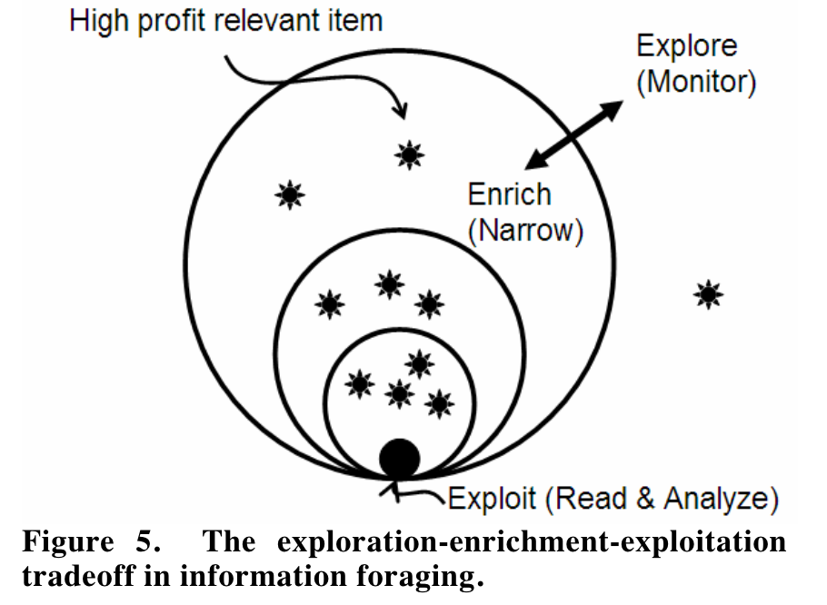
Leverage Points: Foraging Loop
Tradeoff between three processes
Exploring
Increase span of new information
Enriching
Create small high precision set of documents
Exploiting
In-depth analysis, information, patterns, inferences

Slide 17
Leverage Points: Foraging Loop
The cost structure of the exploration-enrichment-exploitation tradeoff, which is related to the precision-recall trade-off in information retrieval.
Exploring more vs cost of working and exploiting it (Optimize focus and context)
The cost structure of scanning, recognizing (assessing), and selecting items for further attention.
Find relevant items (highlight information, document representation)
The cost of shifting attentional control.
Starting or switching to new task
The cost of follow-up searches.
New question and hypothesis requires additional search

Slide 18
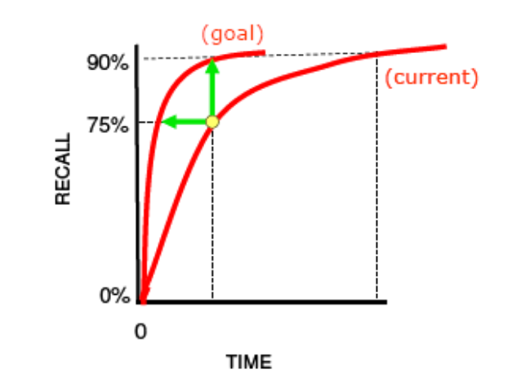
A cost structure metric for the foraging loop.
Way of measuring progress
Initially, get more information and try not to miss relevant information
With experience, expert analyst can get more information in short time

Slide 19
Leverage Points: Sense making loop
Concerns Problem Structuring, Evidentiary Reasoning, and Decision Making
Span of attention for evidence and hypotheses
Attention is limited by human memory capacity
Offloading information to external memory (visual display)
Generation of alternative hypotheses
Human bias in existing schemas and expectation
Improving the possibilities covered by generated hypothesis.
Confirmation bias
Fail to focus on disconfirmation of hypothesis
Need to evaluate whether the hypothesis is correct or not

Slide 20
Conclusion
Notional Model of Sense Making process
Intelligence analysis as a form of sensemaking and expert skill
Leverage points to improve methodology or technology

